Slide 1


LUMP SUM GRANTS
Vincent Declerfayt
Head of Administration and Finance, Global Health EDCTP3
Abdoulie Barry
Executive Director and Director of Finance and Administration, EDCTP Association
Silvia Garcia
Scientific Project Officer, Global Health EDCTP3
Neodia Mensing-Flores
Financial Officer, Global Health EDCTP3
16 June 2025
07:45 – 08:45

Slide 2
Disclaimer
This document/presentation is non-binding and designed for information purposes to support participants to Global Health EDCTP3 actions in the management of their projects.
It is based on the legal framework applicable to Global Health EDCTP3 activities, namely Council Regulation 2021/2085 (basic act), European Parliament and Council Regulation 2021/695 (Horizon Europe Regulation), the Global Health EDCTP3 2025 work programme and the Horizon Europe Lump Sum Model Grant Agreement.

Slide 3


Agenda
Introduction – Vincent Declerfayt, Head of Administration and Finance, Global Health EDCTP3 and Abdoulie Barry, Executive Director and Director of Finance and Administration, EDCTP Association
Writing, Evaluation and Grant Agreement preparation for Lump-sum proposals- Silvia Garcia, Scientific Project Officer, Global Health EDCTP3
Budget allocation, payment schedule, reporting and payment, ex-post controls- Neodia Mensing-Flores, Financial Officer, Global Health EDCTP3
How to fill in the detailed budget table in lump-sum proposals - Neodia Mensing-Flores, Financial Officer, Global Health EDCTP3
AOB - Q&A Session- All

Slide 4
Introduction
Vincent Declerfayt
Head of Administrator and Finance, Global Health EDCTP3
Abdoulie Barry
Executive Director and Director of Finance and Administration, EDCTP Association

Slide 5




Global Health EDCTP3
€1.86Bn
Established in 2021, Global Health EDCTP3 is a partnership between the European Commission, representing the European Union, and the EDCTP Association, representing the governments of 15 European and 30 sub-Saharan African countries.
European Union
€910 M
Member States
(EDCTP Association)
€550 M
Third parties
€400 M
Notes:
Provide examples of direct and indirect costs.

Slide 6
Governance structure
Global Health EDCTP3
Governing Board
(ultimate decision-making body)
Stakeholders
Group
EDCTP
Africa Office
3M Grant
for 2023-2025
Advisory bodies
EDCTP
Association
(6 members)
European
Commission
(6 members)
Scientific
Committee
30 African &
15 European
countries
Global Health EDCTP3 Programme Office
Contributing Partners

Slide 7
EDCTP Association Members
European Countries
Austria
Belgium
Denmark
Finland
France
Germany
Ireland
Italy
Luxembourg
Netherlands
Norway
Portugal
Spain
Sweden
United Kingdom
African countries
Benin
Burkina Faso
Cameroon
Cote d’Ivoire
Democratic Republic of the Congo
Congo
Eswatini
Ethiopia
Gabon
The Gambia
Ghana
Guinea-Bissau
Guinea-Conakry
Kenya
Liberia
Mali
Malawi
Mozambique
Namibia
Niger
Nigeria
Rwanda
Senegal
Sierra Leone
Somalia
South Africa
Tanzania
Uganda
Zambia
Zimbabwe
Aspirant members
Angola
Switzerland

Slide 8
Role and responsibilities
The role of Global Health EDCTP3 JU
The role of EDCTP Association
Granting authority, following the Joint Undertaking EU regulations and laws​
Horizon Europe grants
Operations​
Research and development of the annual Work Programmes based on the SRIA and Global Health priorities​
Call for Proposals and Grant management: running evaluations, closing grant agreements with the beneficiaries, project monitoring, payments and ex-post ​
Programme office to the governance structure ​
Monitoring the implementation of the Work Programmes and the Strategic Innovation Agenda (SRIA) ​
Partnership building, collaboration with the key global players​
Works in collaboration with its Members: The European Union (represented by the European Commission) and the EDCTP Association
Visit our website: globalhealth-edctp3.eu
Partner in the Global Health EDCTP 3 governance structure, including Governing Board​
Contributes to the strategic orientation and decisions​
Founding Member of EDCTP3 Programme​
Continues to support with the overall compliance of the Programme, with trainings and ex-ante ex-post role in complement to the JU
The role of the Africa Office
Partner in the Global Health EDCTP 3 governance structure, including Governing Board​
Contributes to the strategic orientation and decisions​
Founding Member of EDCTP3 Programme​
Continues to support with the overall compliance of the Programme, with trainings and ex-ante ex-post role in complement to the JU

Slide 9


EDCTP Association and Global Health EDCTP3
One of the two Members of the Joint Undertaking together with the European Commission
Secretariat based in The Hague and Cape Town
Complete the administration of EDCTP2 projects under Horizon 2020
Work towards increased engagement and visibility of EDCTP programmes in Africa
Partnership between the EDCTP Association and the European Commission
Global Health EDCTP3 Joint Undertaking and its Programme Office are based in Brussels
Responsible for the implementation of the 3rd EDCTP Programme under Horizon Europe
Granting authority for the grants under Horizon Europe

Slide 10
EDCTP Association and Global Health EDCTP3
Guide African countries that are members of the EDCTP Association through the activities of the Global Health EDCTP3
Organise FPMT in support to Global Health EDCTP3 (Africa Office Grant)
Launch calls and implement EDCTP3 grants under Horizon Europe
Collaborate with the EDCTP Association and the European Commission – to reach the 3rd programme’s objectives

Slide 11
Lump Sum grant - Role of EDCTP Association:
Coordinator for the projects selected under the following calls (stage 2):
  HORIZON-JU-GH-EDCTP3-2025-02-FELLOWSHIP-01-two-stage: Global Health EDCTP3 JU, and contributing partners funded Strategic Training Hubs for Fellowships in Public Health covering Biostatistics, Epidemiology and Modelling
  HORIZON-JU-GH-EDCTP3-2025-03-NETWORKS-01-two-stage: Global collaborative action for strengthening the Regional Networks of Excellence and Epidemic Preparedness Consortia
Key tasks of the Coordinator (per Annotated Grant Agreement):
Monitor that the action is implemented properly
Act as the intermediary for all communications
Request and review documents or information required by the granting authority and verify their completeness and correctness
Submit the deliverables and reports in the system
Distribute payments to the other beneficiaries
Notes:
Deadline for the second stage: 2 Sept 2025

Slide 12
Why do we use lump-sum funding?
  Significant simplification potential
  Despite all simplification, funding based on reimbursement of actual costs remains complex and error-prone
  Lump sum project funding removes all obligations on actual cost reporting and financial ex-post audits – i.e. a major reduction of administrative burden
  Access to the programme becomes easier, especially for small organisations and newcomers
  Focus on content
  Less focus on financial management and more focus on the scientific-technical content of projects
  Opportunity for the Global Health EDCTP3 to integrate the overall European Commission Research Family strategy, and pilot model for simplification in a pilot to learn from its programme specificities

Slide 13
Basic principles
Lump-sum evaluation and grant agreement follow the standard approach (similar as for actual costs grants) with the same:
  Evaluation criteria
  Pre-financing and payment scheme
  Reporting periods and technical reporting, though focusing on completion of work packages
  One lump sum share is fixed in the grant agreement for each work package:
Work package completed
Payments do not depend on a successful outcome, but on the completion of activities
Work packages can be modified through amendments (e.g. to take into account new scientific developments)
No intention and nor basis for judging the performance of lump-sum grants more strictly than the performance of other grants
PAYMENT

Slide 14
Two lump-sums options
Type 1
Lump-sum fixed in the call for proposal
Type 2
You define the lump-sum in your proposal
Used for CSA topics in EDCTP 3 WP 2025

Slide 15
Writing, Evaluation and GA preparation for Lump-sum proposals
Silvia Garcia
Scientific Project Officer, Global Health EDCTP3

Slide 16
Writing a lump-sum proposal
No impact on the writing of the stage 1 (short proposal) but in stage 2 – full proposal
To write a lump-sum proposal
To define and justify the lump-sum
Use the standard Horizon Europe application form
Present the objectives and methodology of your project and address the expected outcomes and impacts as in any Horizon Europe proposal
Describe in detail the activities covered by each work package.
Need to provide a detailed budget table with cost estimations that are an approximation of your actual costs and meet the eligibility criteria of Horizon Europe.
Costs estimations needed for each cost category per beneficiary (and affiliated entity if any) and WPs
Detailed budget table (Excel file)
  → must be downloaded from the online submission system, fill it and submit it as an annex to the Part B of your application form.

Slide 17
Project design – work packages
  Work package distribution
  A work package (WP) is a major sub-division of the work plan of your project
As many as needed but not more than what is manageable
A single activity is not a WP
A single task is not a WP
A % of progress is not a WP (e.g. 50 % of the tests)
A lapse of time is generally not a WP (e.g. activities of year 1)
Work packages with a long duration may be split along the reporting periods (e.g., Coordination and Management, Dissemination and Exploitation, etc.). In this way, the relevant activities can be paid at the end of the reporting period

Slide 18
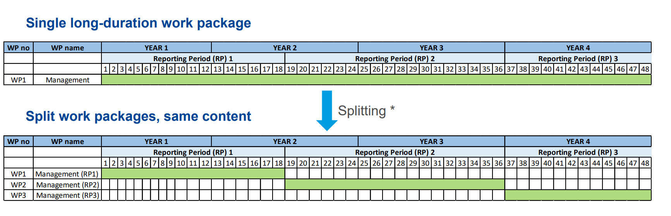
Splitting work packages- examples
*Splitting WPs along the boundaries of reporting periods allows activities to be reimbursed at intermediate payments
*It is possible that the resulting work packages contain the same tasks (e.g. project management). In this case,
there is no need to repeat the same description for each split work package in the proposal (part B, table 3.1b)

Slide 19
Acceptance of work packages
  Work packages are accepted if the activities have been carried out. We can also accept them when all essential tasks have been completed, when equivalent tasks have been carried out, or when deviations have been justified.
  Lump-sum projects can be amended according to scientific-technical needs (or deviations can be justified in the reports). Use these mechanisms to make completion of work packages feasible.
  Before a lump-sum work package (that you declared completed) is rejected as incomplete, you are invited to respond to the observations of the project officer.
  If the rejection is upheld the lump sum share concerned is not paid at that point in time. You should complete the work package later and declare it at the end of any subsequent reporting period.
  If it is not possible to complete a work package by the end of the project (e.g., for technical reasons or due to force majeure), the lump-sum is paid partially in line with the degree of completion. The decision on the partial amount is taken on a case-by-case basis. You will be able to provide observations.

Slide 20
Evaluation of a lump-sum proposal (1/2)
  Evaluation of lump-sum occurs at stage 2 only (full proposal)
  Evaluation of lump sum proposals follows the same overall approach as for actual cost grants. Your proposal will be evaluated by independent experts against the standard evaluation criteria: excellence, impact, and implementation. The cost estimations will be assessed against the proposed activities under the Quality/Implementation/Resources award criteria.
  Experts will:
    ensure that the cost estimations are reasonable and non-excessive (including with checking the budget estimate on the basis of relevant statistical data)
    evaluate whether the proposed resources and the split of the lump sum allow completing the activities described in the proposal.
    Verify that proposals include the declaration by beneficiaries of having used their own accounting practices
Personnel costs dashboard provides a reference data about the range of normal personnel costs per country, helping the evaluators to judge if personnel cost estimations in a proposal are reasonable
  The JU will provide personnel costs dashboard that shall be used to ensure that budgets are reasonable and non-excessive

Slide 21
Evaluation of a lump-sum proposal (2/2)
  If the experts find overestimated costs, they make concrete recommendations on the budget that are recorded in the Evaluation Summary Report, but the score will not be decreased.
  Serious problems with the lump sum budget (e.g., a budget unfit for purpose or strongly overestimated costs) lead to a decreased score under the implementation criterion.
  Possible changes to the lump sum budget following evaluation are typically:
    removal of ineligible costs (i.e. costs that do not meet the standard cost eligibility conditions of the programme; see above)
    removal of erroneously duplicated cost items
    correction of overestimated or underestimated costs.
  For that reason, if you have high personnel costs, especially personnel costs above the values shown in the dashboard, please justify them in the comment tab of your detailed budget table (for more details, see the instructions in the detailed budget table)
  Changes to the lump sum budget can lead to a lower lump sum and/or to the transfer of budget between different activities or different partners. An increase of the lump sum (i.e. of the maximum grant amount) is NOT possible.
  This will be reflected in a modified lump sum amount in the grant agreement followed-up by the JU during GAP phase.

Slide 22
Grant agreement preparation
  The grant agreement for your project will be based on the Model Grant Agreement for lump sum grants.
  The ‘no negotiation’ principle applies. The grant agreements is prepared on the basis of the proposal you submitted. However, some changes might be necessary:
    correcting obvious errors and inconsistencies
    other changes necessary to comply with applicable rules
    adjustment of the lump sum to the amount specified in the Evaluation Summary Report (ESR)
  The breakdown of lump sum shares per beneficiary and per work package is included in the grant agreement as Annex 2. The submitted detailed lump sum budget table is not part of the lump sum grant agreement.
  Once the lump sum is fixed in the grant agreement, it will not be questioned if the prices for goods or services change later on.

Slide 23
Budget allocation, payment schedule, reporting and payment, ex-post controls
Neodia Mensing-Flores
Financial Officer , Global Health EDCTP3

Slide 24
Budget allocation
  Budget allocation (Annex 2 to the grant agreement)
 | WP1 | WP2 | WP3 | WP4 | WP5 | WP6 | WP7 | WP8 | Total
Beneficiary A | 250.000 |  |  | 50.000 | 300.000 | 250.000 |  | 300.000 | 1.150.000
Beneficiary B |  | 250.000 | 350.000 | 50.000 |  |  | 100.000 | 150.000 | 900.000
Beneficiary C | 100.000 | 100.000 |  | 50.000 |  | 280.000 |  |  | 530.000
Beneficiary D |  | 120.000 |  | 50.000 |  |  | 100.000 | 150.000 | 420.000
Total | 350.000 | 470.000 | 350.000 | 200.000 | 300.000 | 530.000 | 200.000 | 600.000 | 3.000.000
Shares of the lump sum per beneficiary
Lump sum
=
Maximum grant amount
Shares of the lump sum per WP
  You can use the budget as you see fit as long as the project is implemented as agreed. The actual distribution of the lump sum is invisible to us.
  Budget transfers between work packages and/or partners require an amendment if the consortium wants to reflect them in the grant agreement.

Slide 25

Payment schedule
Types of payments
  Same function and same rules as for other grants
  Coordinator distributes the amount according to consortium agreement
  One or more
  We pay the shares of the lump sum set out in Annex 2 for the work packages completed & approved in the reporting period
  Closes the financial aspects of the grant
  Partial payment for partially completed WPs possible
  Releases the amount retained for the Mutual Insurance Mechanism
Pre-financing payment
Interim payment(s)
Payment of the balance

Slide 26
Reporting and payment
The financial report is much simplified and to a large extent automated.
The financial statement for all beneficiaries is automatically generated (based on the accepted work packages and the corresponding lump sum shares).
 | WP1 | WP2 | WP3 | WP4 | WP5
Beneficiary A | 250.000 |  |  | 50.000 | 300.000
Beneficiary B |  | 250.000 | 350.000 | 50.000
Beneficiary C | 100.000 | 100.000 |  | 50.000
Beneficiary D |  | 120.000 |  | 50.000
Total | 350.000 | 470.000 | 350.000 | 200.000 | 300.000
Interim payments pay the lump sum shares for completed work packages.
Final payments can also pay partially completed work packages.
✓
✗
✓
✗
Payment = 350 000 + 0 + 350 000 + 0 = 700 000 €

Slide 27

Ex-post controls
Checks, reviews and audits for:
Proper implementation of the action (e.g. technical review)
Compliance with the other non-financial obligations of the grant, e.g.
  IPR obligations
  Ethics and integrity
  Open science
  Dissemination
  Etc.
No financial checks, reviews and audits by EU services

Slide 28
Ex-post controls
Consortium needs to keep (e.g.)
Technical documents
Publications, prototypes, deliverables
Consortium doesn't need to keep*
Time-sheets
Pay-slips or contracts
Depreciation policy
Invoices
…any documents proving the actual costs incurred
Documentation required by good research practices such as lab books
…any document proving that the work was done as detailed in Annex 1
*Participants still need to comply with financial record keeping obligations outside the grant agreement, if any (e.g., under national law or internal procedures)
Same as for all Horizon Europe grants

Slide 29
How to fill in the detailed budget table in lump-sum proposals?
Neodia Mensing-Flores
Financial Officer , Global Health EDCTP3
Notes:
Only submitted for 2nd stage evaluation.

Slide 30
What is the detailed budget table for lump sum proposals?
To define and justify the amount of the lump sum proposed by applicants, lump sum proposals
type 2 must contain a detailed budget table.
In this table, you provide cost estimations for each cost category per beneficiary and per work
package.
The table automatically generates the breakdown of the lump sum per beneficiary and per work
package.
The detailed budget table is an Excel file (annex to proposal Part B). Applicants must download it from the online submission system.
Notes:
To define and justify the amount of the lump sum proposed by applicants, lump sum proposals type 2 must contain a detailed budget table.
In this table, you provide cost estimations for each cost category per beneficiary and per work package.
The table automatically generates the breakdown of the lump sum per beneficiary and per work package.
For your proposal, you must always use the file provided in the online submission system. The template is available on the Funding & Tenders Portal is for information only

Slide 31
Which costs must be covered?
Cost estimations:
must be in line with beneficiaries’ normal practices
must be reasonable / not excessive
must be in line with the activities proposed
are subject to the basic eligibility rules of Horizon Europe (cost estimations can be included only if the same cost item / type of cost would be eligible in an actual costs grant)
Depending on the type of the action, these costs and categories of costs may be the following:
Direct personnel costs: employees or equivalent (resolved by staff category); natural persons under direct contract; seconded persons; SME owners and natural person beneficiaries
Direct subcontracting costs
Direct purchase costs: travel and subsistence; equipment; other goods, works and services
Other cost categories: financial support to third parties; internally invoiced goods and services; transnational access to research infrastructures costs; virtual access to research infrastructures costs; PCP/PPI procurement costs
Notes:
To define and justify the amount of the lump sum proposed by applicants, lump sum proposals type 2 must contain a detailed budget table.
In this table, you provide cost estimations for each cost category per beneficiary and per work package.
The table automatically generates the breakdown of the lump sum per beneficiary and per work package.
For your proposal, you must always use the file provided in the online submission system. The template is available on the Funding & Tenders Portal is for information only

Slide 32
Excel template: few instructions before starting
We recommend to use Excel 2013 or a more recent version
The currency used in the Excel template is EURO
Read the detailed instructions on the first tab of the Excel file
For your proposal, you must always use the file provided in the online submission system. For information only, the template is available on the Funding & Tenders Portal.
Notes:
To define and justify the amount of the lump sum proposed by applicants, lump sum proposals type 2 must contain a detailed budget table.
In this table, you provide cost estimations for each cost category per beneficiary and per work package.
The table automatically generates the breakdown of the lump sum per beneficiary and per work package.
For your proposal, you must always use the file provided in the online submission system. The template is available on the Funding & Tenders Portal is for information only

Slide 33
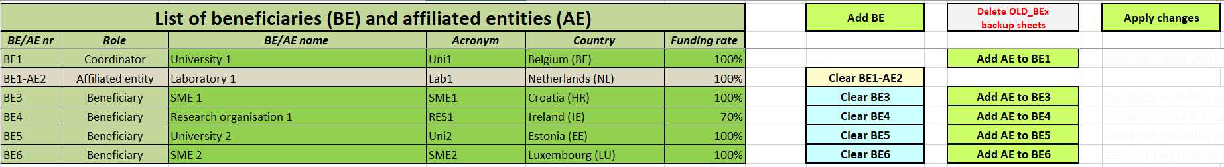
Fill in the beneficiaries list ‘BE list’ sheet
Funding rate for EDCTP3 grants: 100%
Notes:
To add a beneficiary, double click on the ‘Add BE’ button to generate an additional line to the table. You can add as many beneficiaries as needed.
To add an affiliated entity, double click on the ‘Add AE to BEx’ button on the line of the beneficiary to which the entity is affiliated.
For each beneficiary and each affiliated entity, write the name and the acronym of the organisation and chose the correct country and funding rate from the drop-down menus.
Once you have completed the ‘BE list’ sheet, you must double click the ‘Apply changes’ button to generate the corresponding sheets in Excel workbook: one tab will be generated for each beneficiary.

Slide 34
Fill in the work packages list (‘WP list’ sheet)
To add a work package, double click on the ‘Add WP’ button to generate an additional line to the table. You can add as many work packages as needed. Follow the same order as in the Part B of your application.
Once you have completed the ‘WP list’ sheet, you must double click the ‘Apply changes’ button: one table per work package will be added to the beneficiaries’ individual sheets.

Slide 35
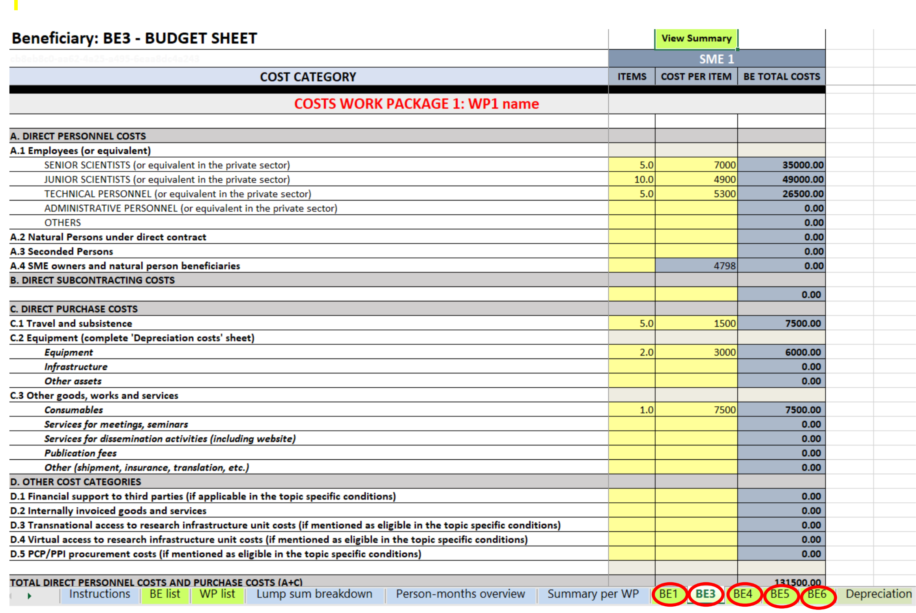
Fill in the individual beneficiary sheets (‘BEx’ tab)
Notes:
Complete one ‘BEx’ sheet per beneficiary. This sheet includes one separate section for each work package. For each work package in which the beneficiary participate, enter the cost estimations under each cost category used.
Enter only the number of items and the cost per item for each cost category (yellow cells). The total costs per cost category are calculated automatically.
For the cost per item, enter only whole numbers (integers).
If the beneficiary does not contribute to a specific work package, leave the cells empty.

Slide 36
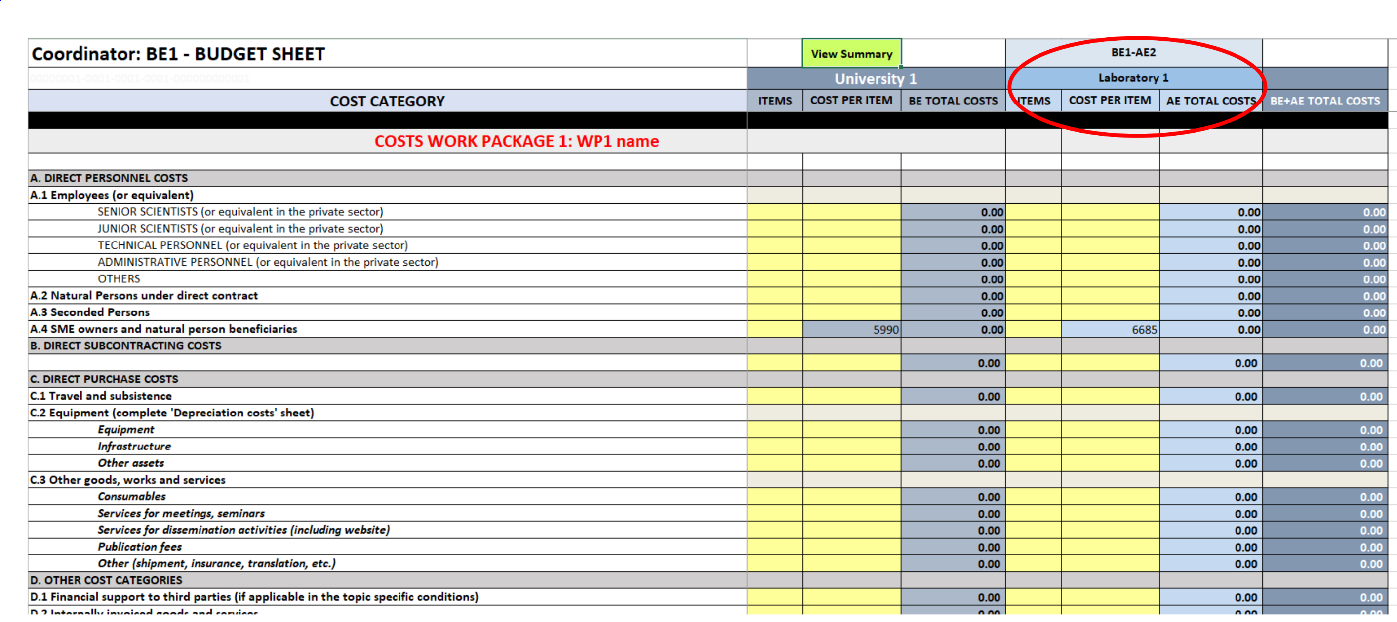
Fill in the individual beneficiary sheets (‘BEx’ tab) – affiliated entities
Notes:
If a beneficiary has an affiliated entity, columns for this entity are generated automatically in the ‘BEx sheet’.
Enter the cost estimations of the affiliated entity in the same way as for the main beneficiary.

Slide 37
Fill in the individual beneficiary sheets
Personnel costs
If your personnelcosts are higher than the values in the dashboard, you must justify them in the ‘Any comments’ tab.
Notes:
Enter the total number of items and the average cost per item for each category of personnel costs
1 item = 1 person-month
For ‘A4. SME Owner and natural person beneficiaries’, the cost per item is predefined
Personnel costs will be evaluated by experts using the EDCTP3 Statistical Data for lump sum evaluations, an
orientation tool that shows the average monthly costs for personnel by country and organisation type

Slide 38
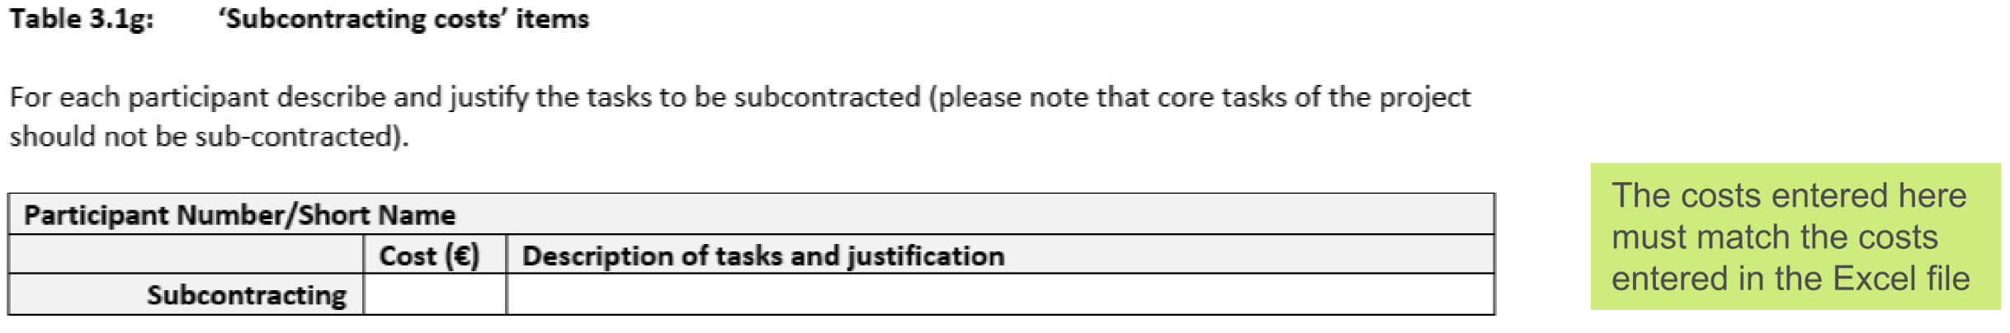
Fill in the individual beneficiary sheets – subcontracting costs
● There is one line for subcontracting per beneficiary and work package (i.e., the amount entered covers all
subcontracting activities for the beneficiary in a work package).
● Enter the number of subcontracted tasks for a given beneficiary and a given work package as number of
items. The cost per item will be an average of the costs of all subcontracted tasks. No more detailed
information is required in the Excel file.
● The tasks to be subcontracted and their costs must be described and justified in the table 3.1g in the part
B of the application form

Slide 39
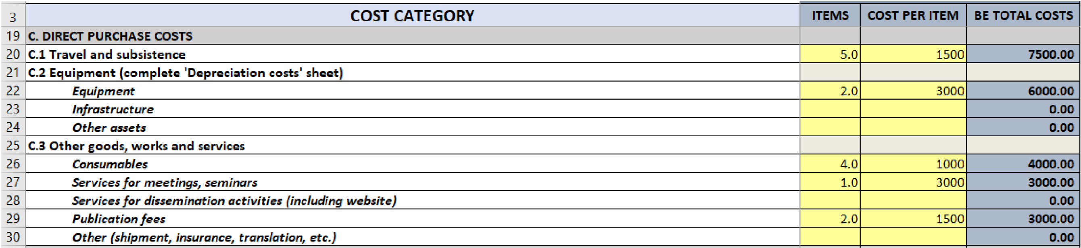
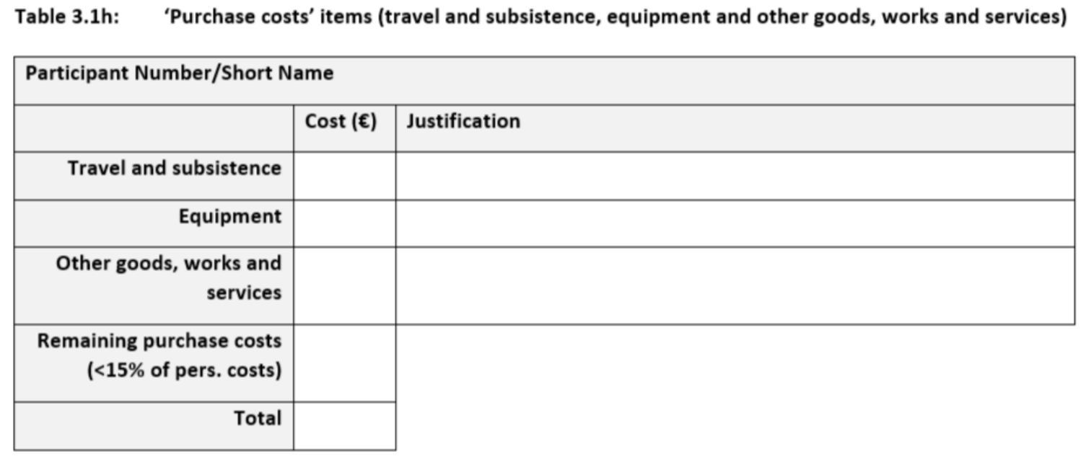
Fill in the individual beneficiary sheets – direct
purchase costs
Enter the total number of items and the average cost per item for each relevant cost category.
The cost per item will be an average of the prices of all
items in the given category for a given beneficiary and
a given work package. No more detailed information is
required in the Excel file.
Table 3.1h must be completed by each beneficiary showing the total purchase cost to be the same as that in the budget. For costs falling below the 15% of Personnel costs, no justification is required.

Slide 40
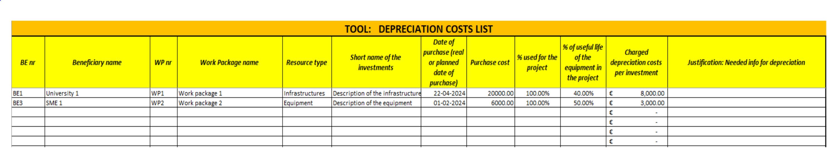
Fill in the individual beneficiary sheets – depreciation costs list
For the category ‘equipment’ (equipment, infrastructure, other assets) you must enter the depreciation costs in the individual beneficiary tabs.
Use the ‘Depreciation costs’ tab to calculate the depreciation costs:
  Fill in the information about the beneficiary, the work package, the resource type, the name of the investment and the date of purchase
  Encode the (estimated) price of the equipment in the column ‘Purchase cost’
  Encode the percentage of usage of the equipment for the project in the column ‘% used for the project’
  Divide the period (in months) during which the equipment is used for the project by the depreciation period (in months) for the equipment. Multiply the results by 100%. Encode the result in the column ‘% use for lifetime of the investment’
Notes:
This amount is NOT automatically transferred to the respective ‘BEx’ tab. You have to add manually the depreciation costs in the dedicated section of the ‘BEx’ tab. If you have several items in the ‘Depreciation costs’ tab for one single section (same beneficiary, same work package and same resource type), you must enter the number of items and add the average of the depreciation costs as ‘cost per item’.
In certain cases, the Work Programme specifies that purchases of equipment, infrastructures and other assets can be declared as full capitalised costs. In that case, the full capitalised costs must be encoded in the section “C.2 Equipment”. At EDCTP3, however, only the depreciation costs are allowed.

Slide 41
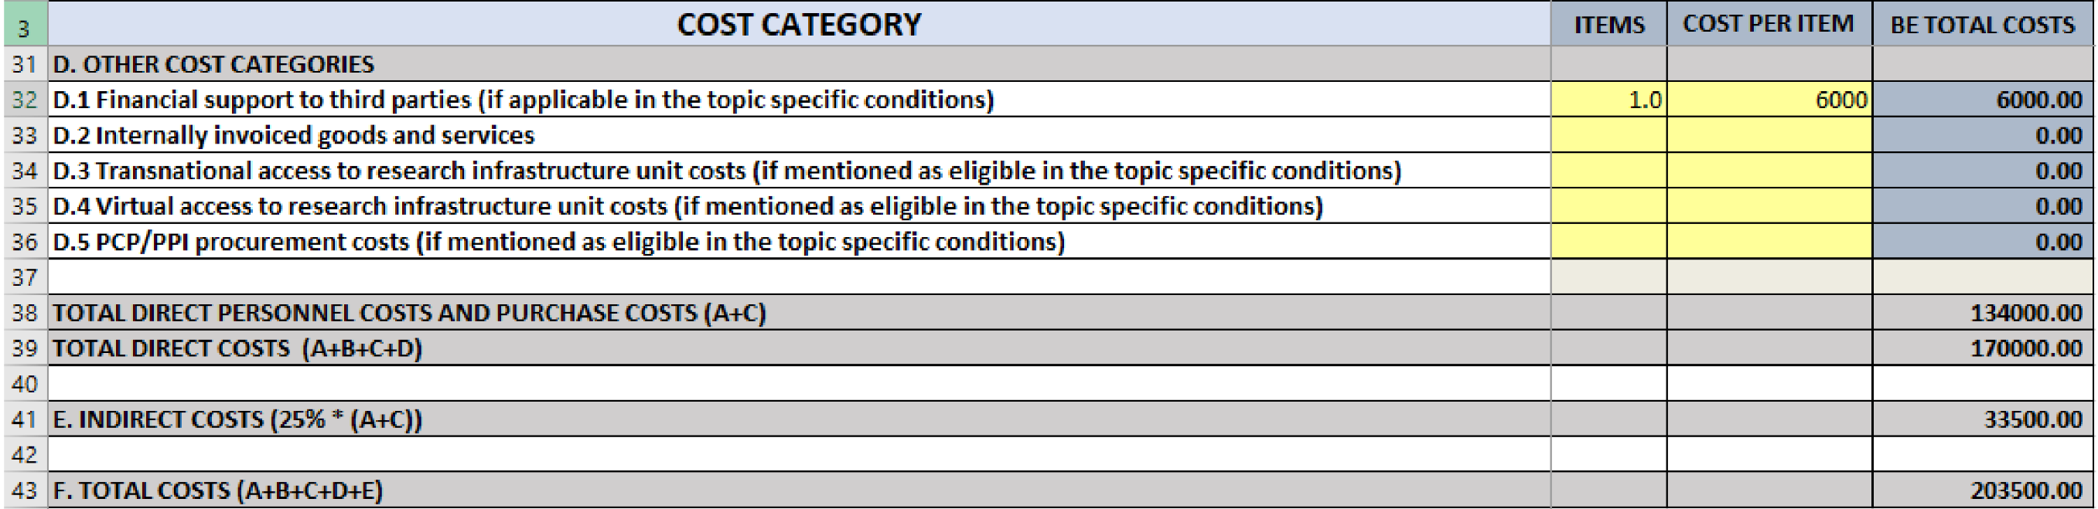
Fill in the individual beneficiary sheets – other
direct costs and indirect costs
Certain types of costs can be entered only if they are explicitly allowed for in the specific conditions of your topic:
  Financial support to third parties
  Transnational access to research infrastructure’ and ‘Virtual access to research infrastructures
  PCP/PPI procurement costs
Indirect costs are calculated automatically.
Total costs are calculated automatically.

Slide 42
Lump-sum breakdown
Part A (online forms)
Excel file
The lump-sum breakdown table is generated automatically. It displays the lump sum shares per beneficiary/affiliated entity and per work package
It applies the funding rate you have chosen in the BE list.
In the part A of the application (online forms), you have to fill in the ‘Budget for the proposal’ table, entering the requested grant amount for each participant. To do so, please use the total amounts per beneficiary in the table ‘Estimated breakdown of the lump sum’ in the Excel file.

Slide 43
Summary tables
The ‘Summary per WP’ and ‘Person-months overview’ tables are produced automatically.
They will be used by evaluators during the evaluation of your proposal.

Slide 44
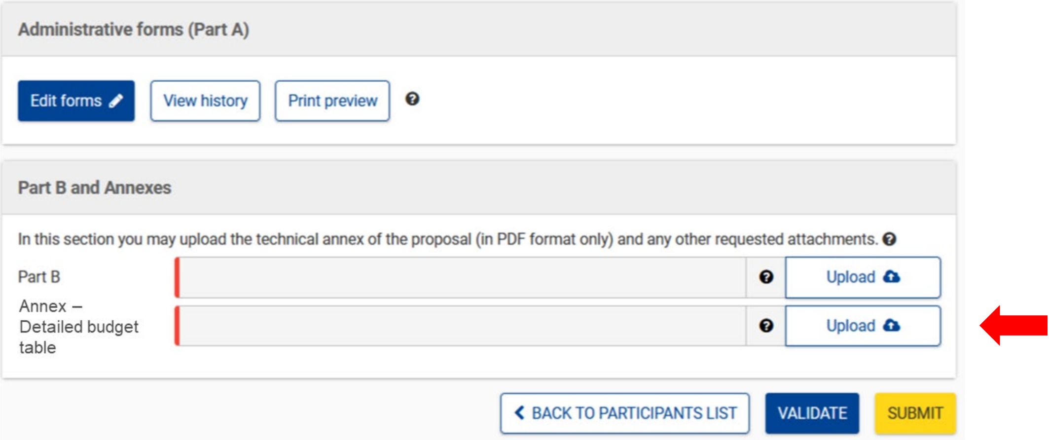

Uploading the Excel file
Once you completed the detailed budget table, upload it in the online submission system, as annex to the part B template.
The format of the Excel template is .xlsm because it uses macros. While you work on it, always save it as .xlsm.
Upload the Excel file in .xlsx or .xls format. For security reasons, you cannot upload the file in .xlsm format.
Always keep a copy of the original .xlsm file.

Slide 45
AOB - Q&A session
Notes:
Only submitted for 2nd stage evaluation.

Slide 46

Resources available
One dedicated lump sum page on the Funding &Tenders Portal with:
Video tutorials
Overview of lump sum funding
Guidance documents
What do I need to know? & Quick guide
Reference documents
Model Grant Agreement Lump Sum
Decision authorising the use of lump sum contributions under the Horizon Europe Programme
Frequently asked questions
Detailed guidance for participants
Lump sum briefing slides for experts
Horizon dashboard for lump sum evaluations
Detailed budget table

Slide 47
Q&A Session
Notes:
Deadline for the second stage: 2 Sept 2025

Slide 48


Thank you
for your attention!
Questions?
https://www.global-health-edctp3.europa.eu/
info@global-health-edctp3.europa.eu
Notes:
For questions that we will not be able to answer, please send an email to the above-mentioned address. Ensure that the title includes EDCTP Forum – Actual Cost Grants Workshop

