Slide 1

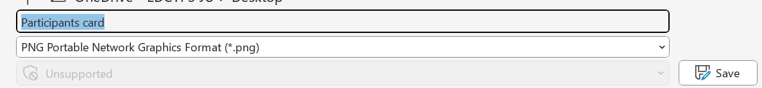
How to create participant card
Fill in the participant’s details in Arial font
Add your picture
Download the file as an image (.png or .jpg)
1
2
3

Slide 2
Name of participant
Position, organisation, country
Participant at the EDCTP Forum

Slide 3
Name of speaker
Position, organisation, country
Speaker at the EDCTP Forum

Slide 4

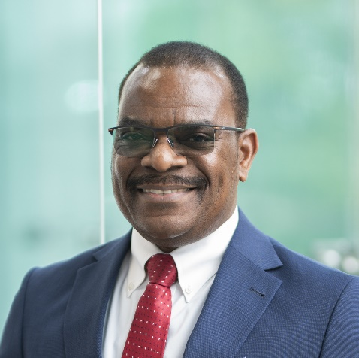
Dr Michael Makanga
Executive Director, Global Health EDCTP3
Speaker at the EDCTP Forum

